Slide 1
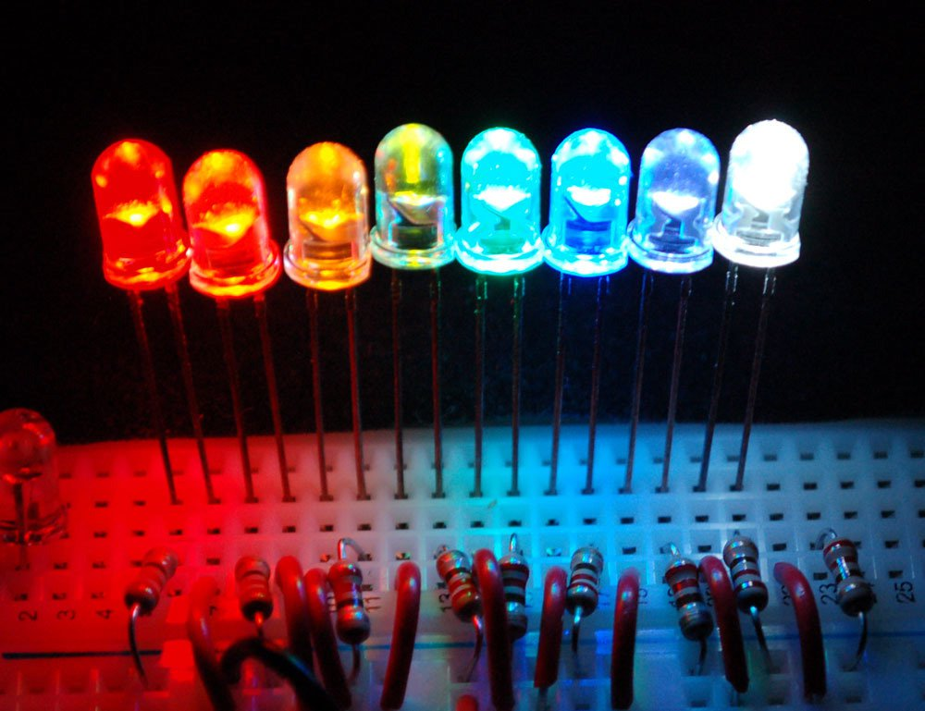
Leds and how to use them
Notes:
Source: https://learn.adafruit.com/all-about-leds/what-is-an-led

Slide 2
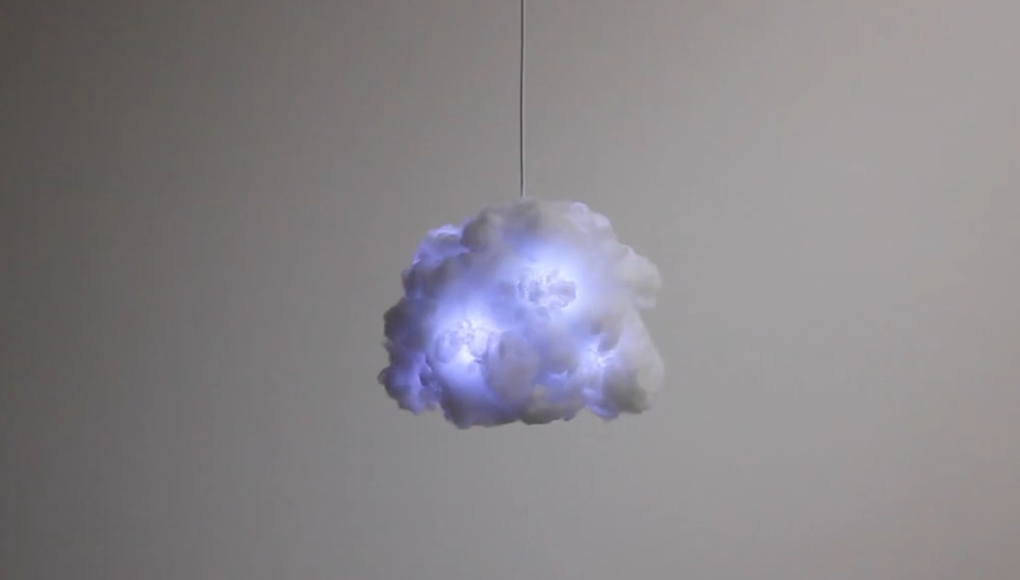
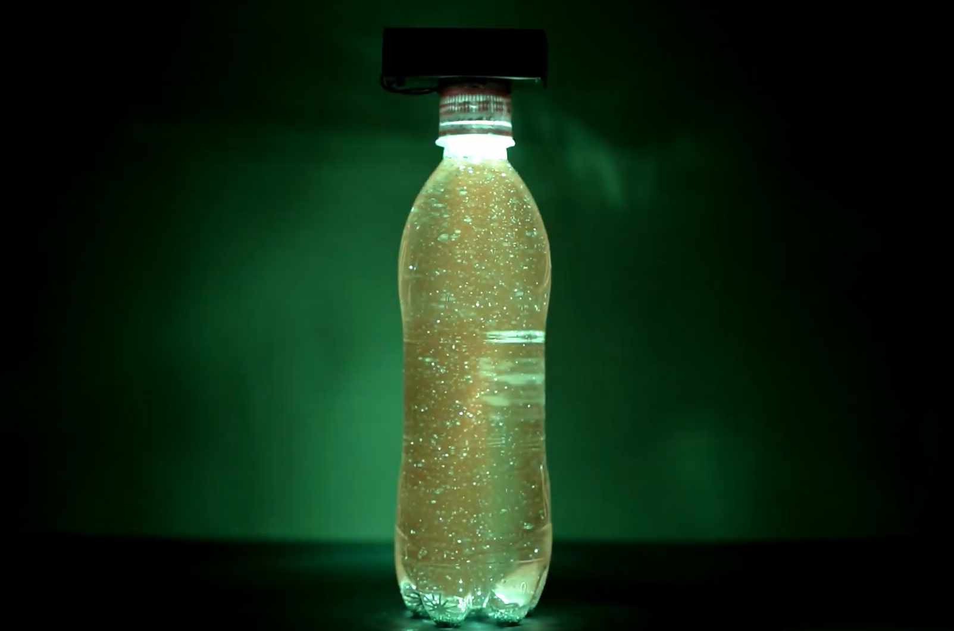
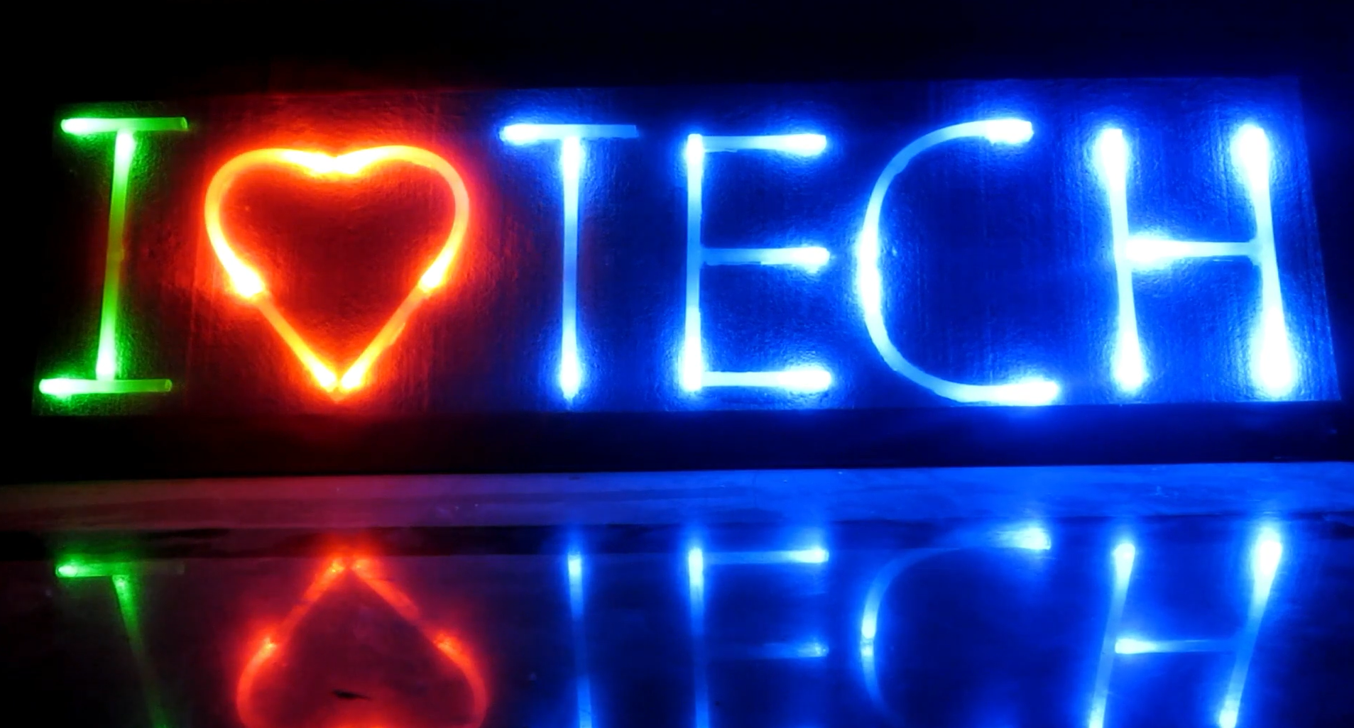
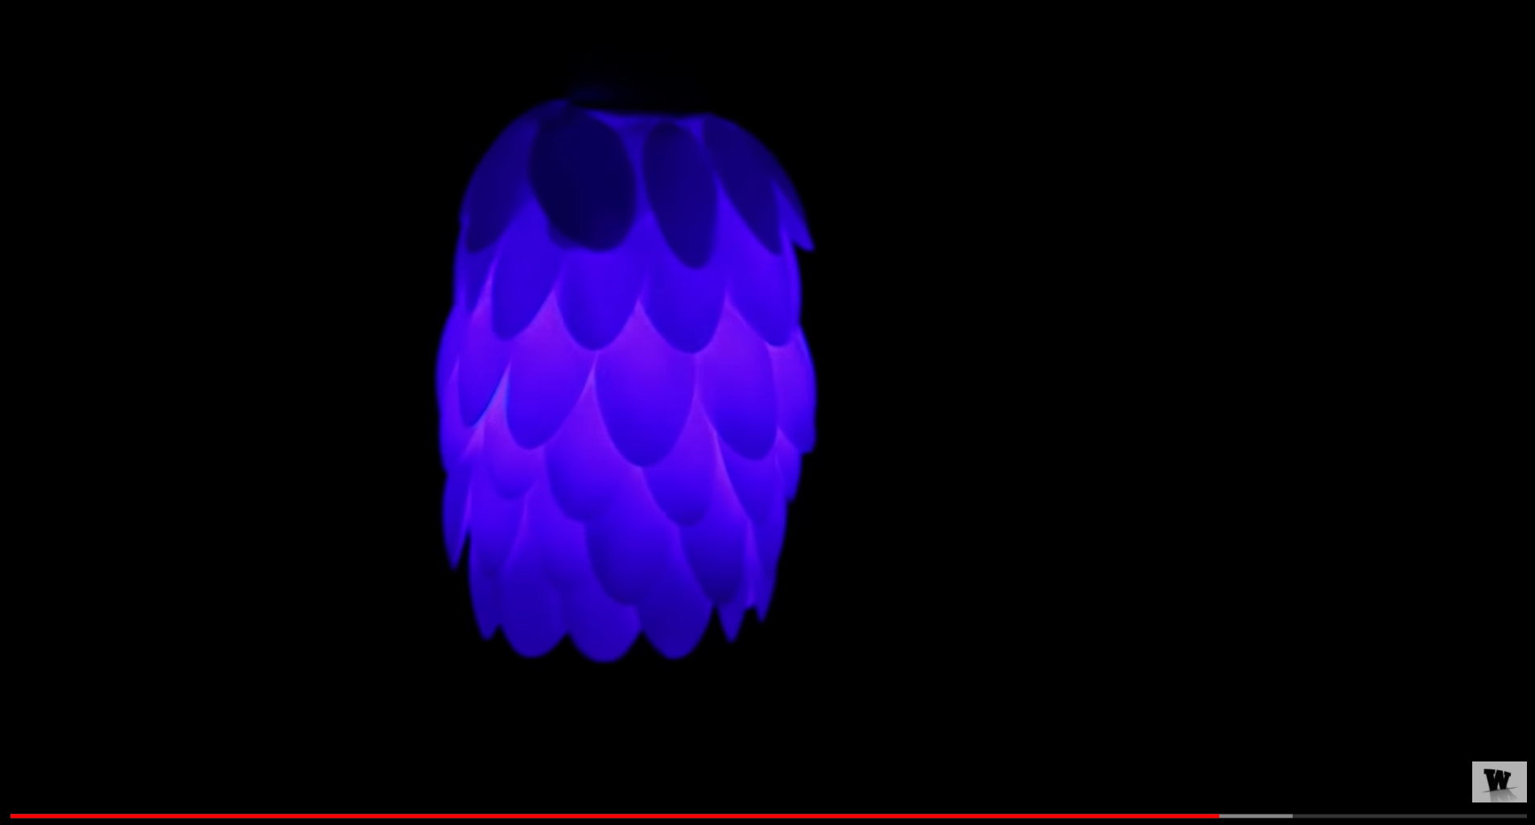
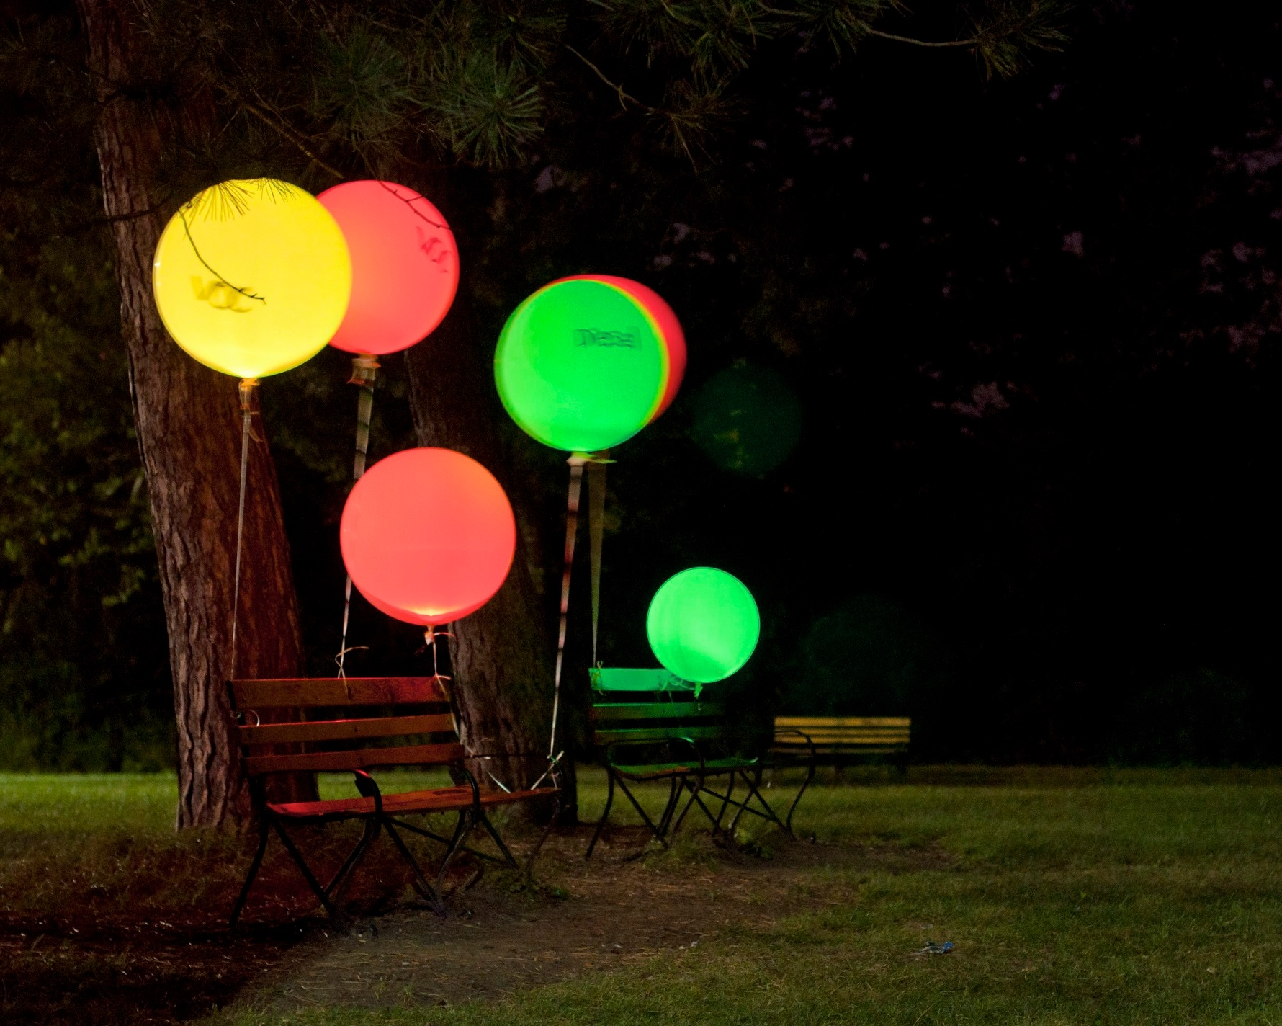
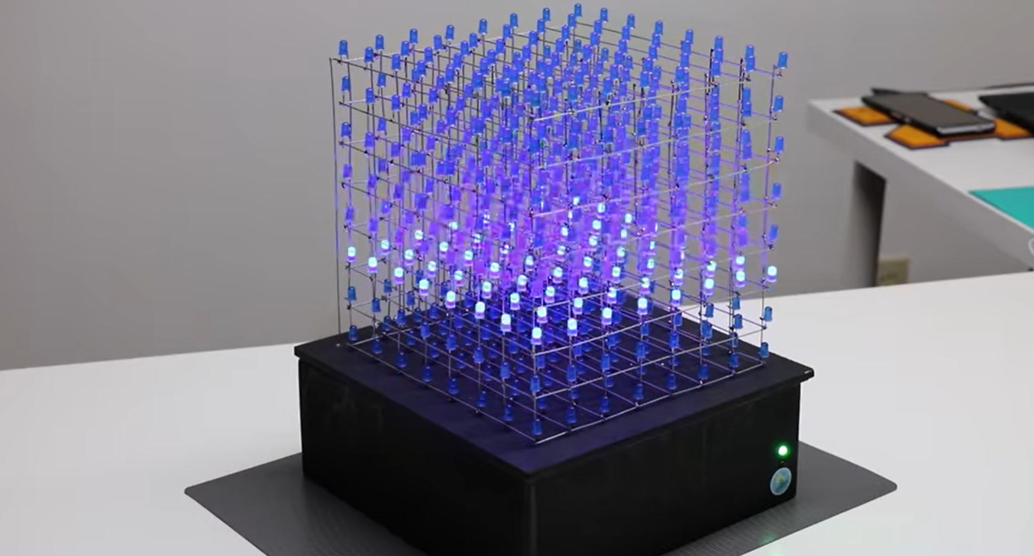
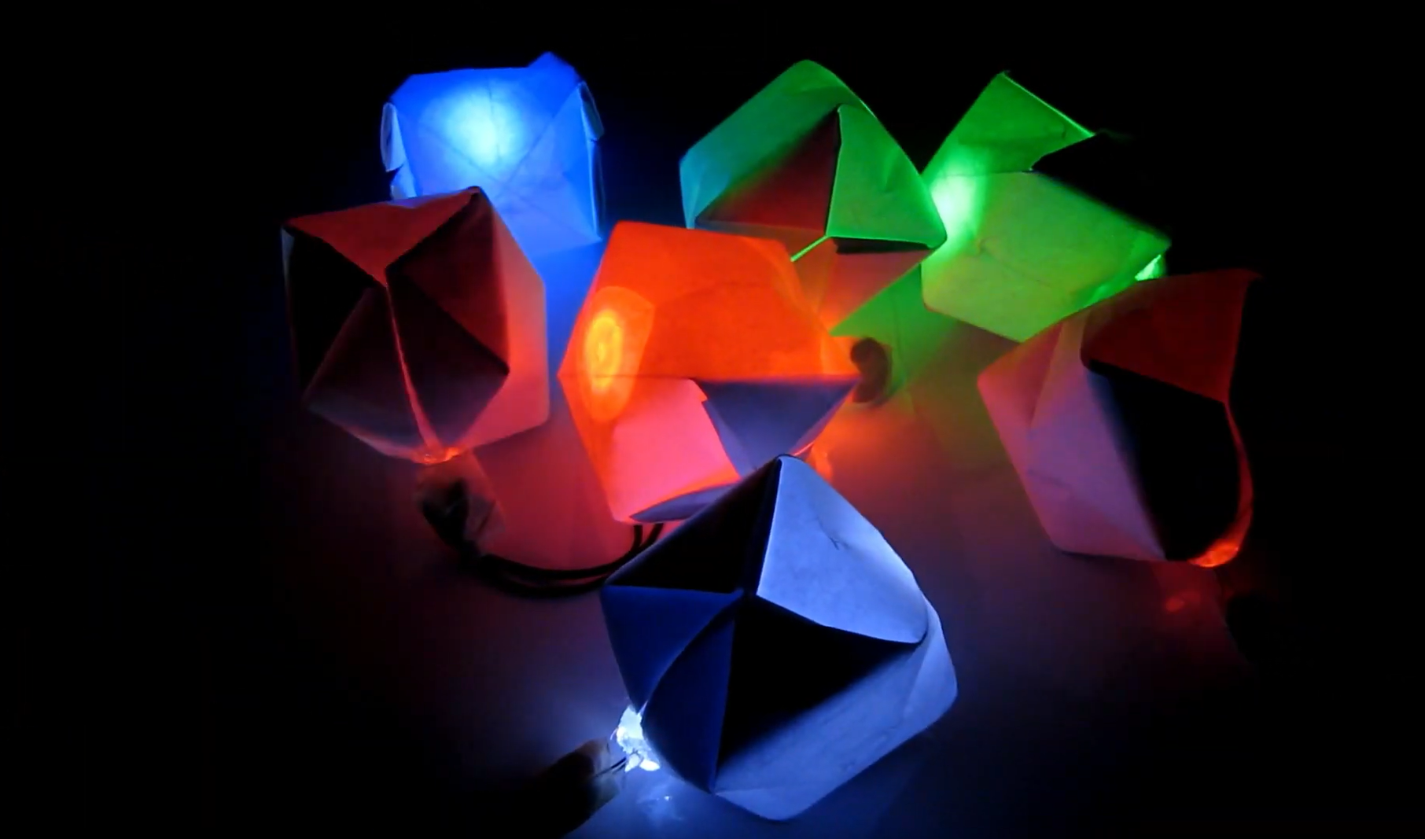

Slide 5
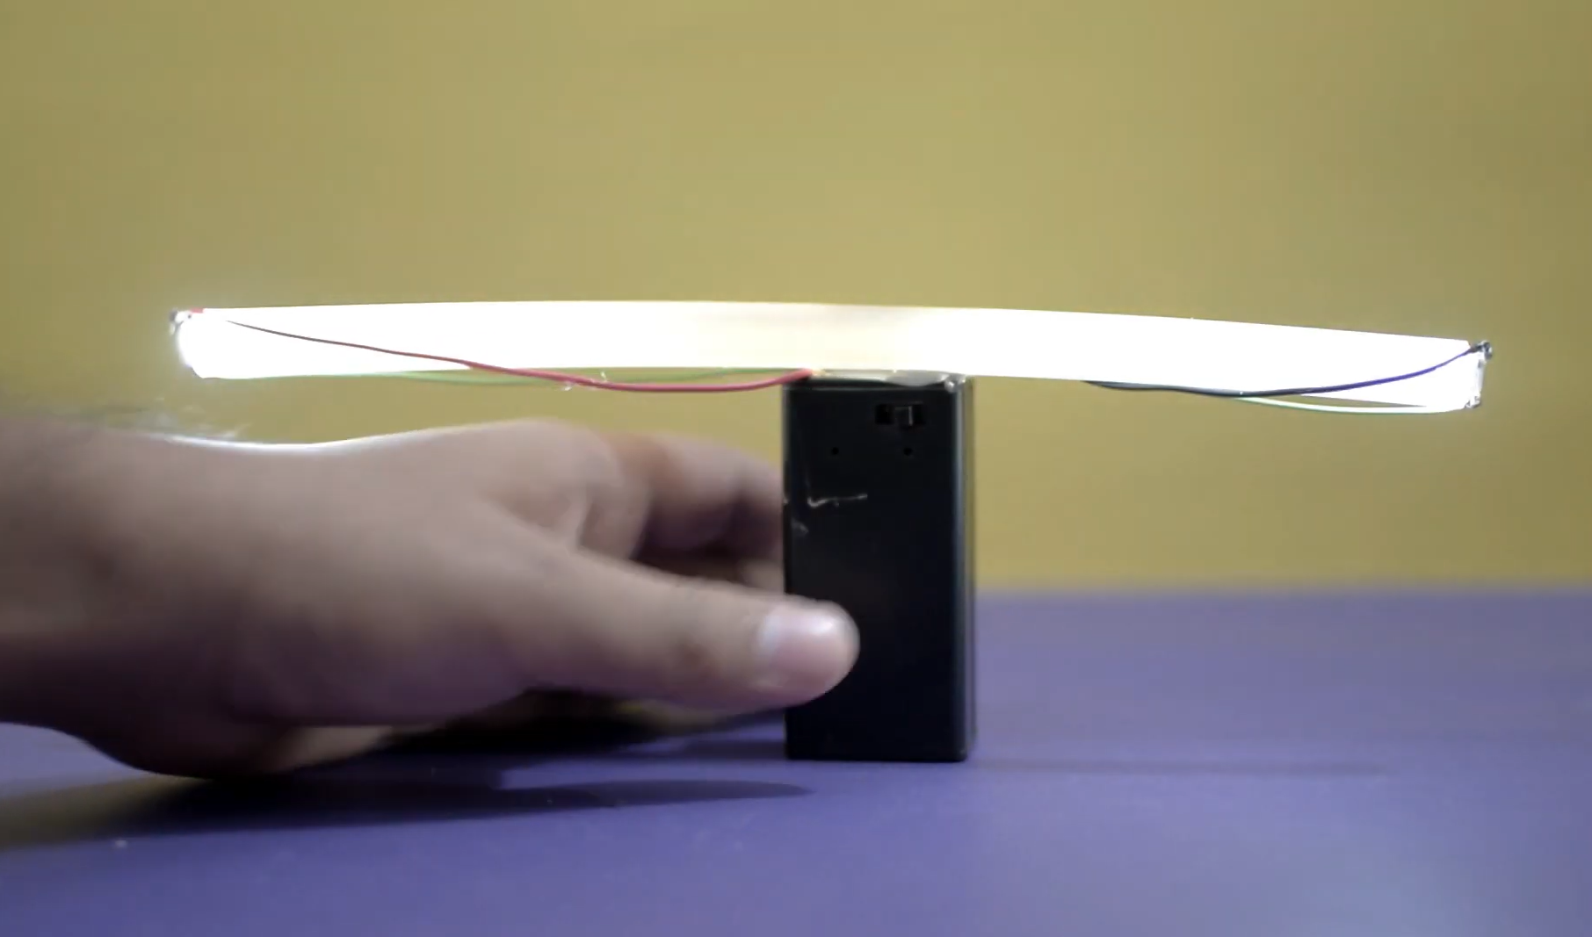
Diffusion with glue stick
https://youtu.be/3frVM7J0nO8
https://youtu.be/3frVM7J0nO8
Diffusion with glue stick
https://youtu.be/3frVM7J0nO8
https://youtu.be/3frVM7J0nO8

Slide 6
Diffusion with spoons
https://youtu.be/OsTKdKdMXKU

Slide 7
Notes:
https://youtu.be/T5Aq7cRc-mU

Slide 8
Notes:
Designer: Richard Clarkson, https://vimeo.com/111889143

Slide 9
Examples
Ambient Sensor Balloons
Kuznetsov et al., UbiComp2011 http://doi.acm.org/10.1145/2030112.2030145
Notes:
Stacey Kuznetsov, George Noel Davis, Eric Paulos, Mark D. Gross, and Jian Chiu Cheung. 2011. Red balloon, green balloon, sensors in the sky. In Proceedings of the 13th international conference on Ubiquitous computing (UbiComp '11). ACM, New York, NY, USA, 237-246. DOI=10.1145/2030112.2030145 http://doi.acm.org/10.1145/2030112.2030145
http://www.instructables.com/id/Air-quality-balloons/

Slide 10
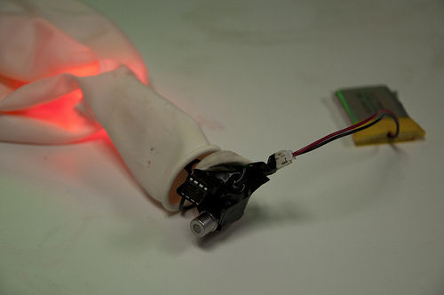
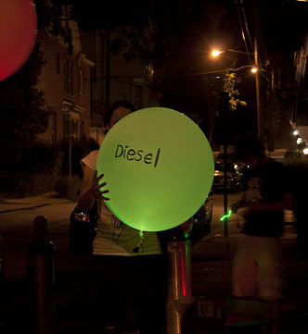
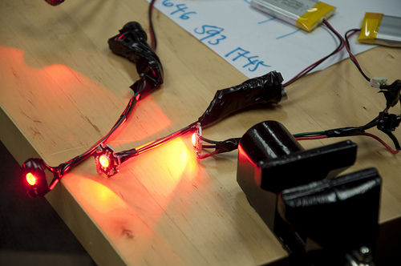
Air quality sensor + microcontroller + RGB LED + battery

Slide 12
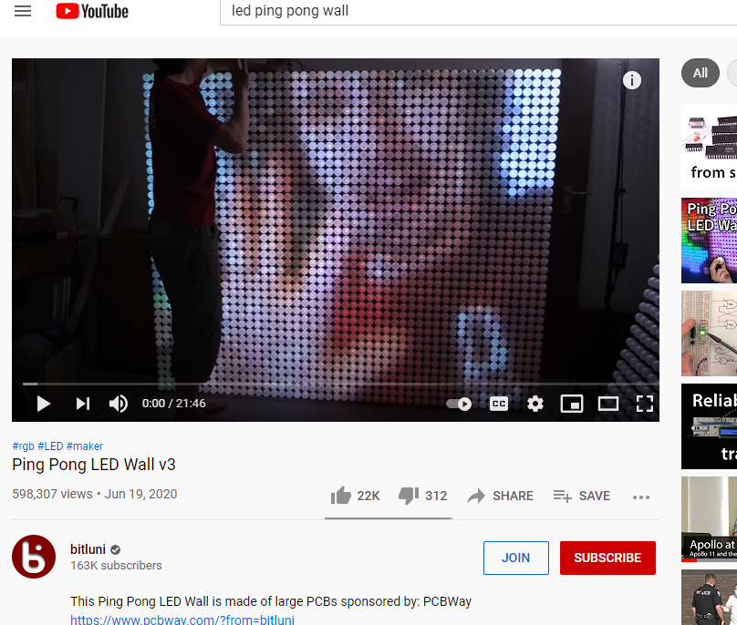
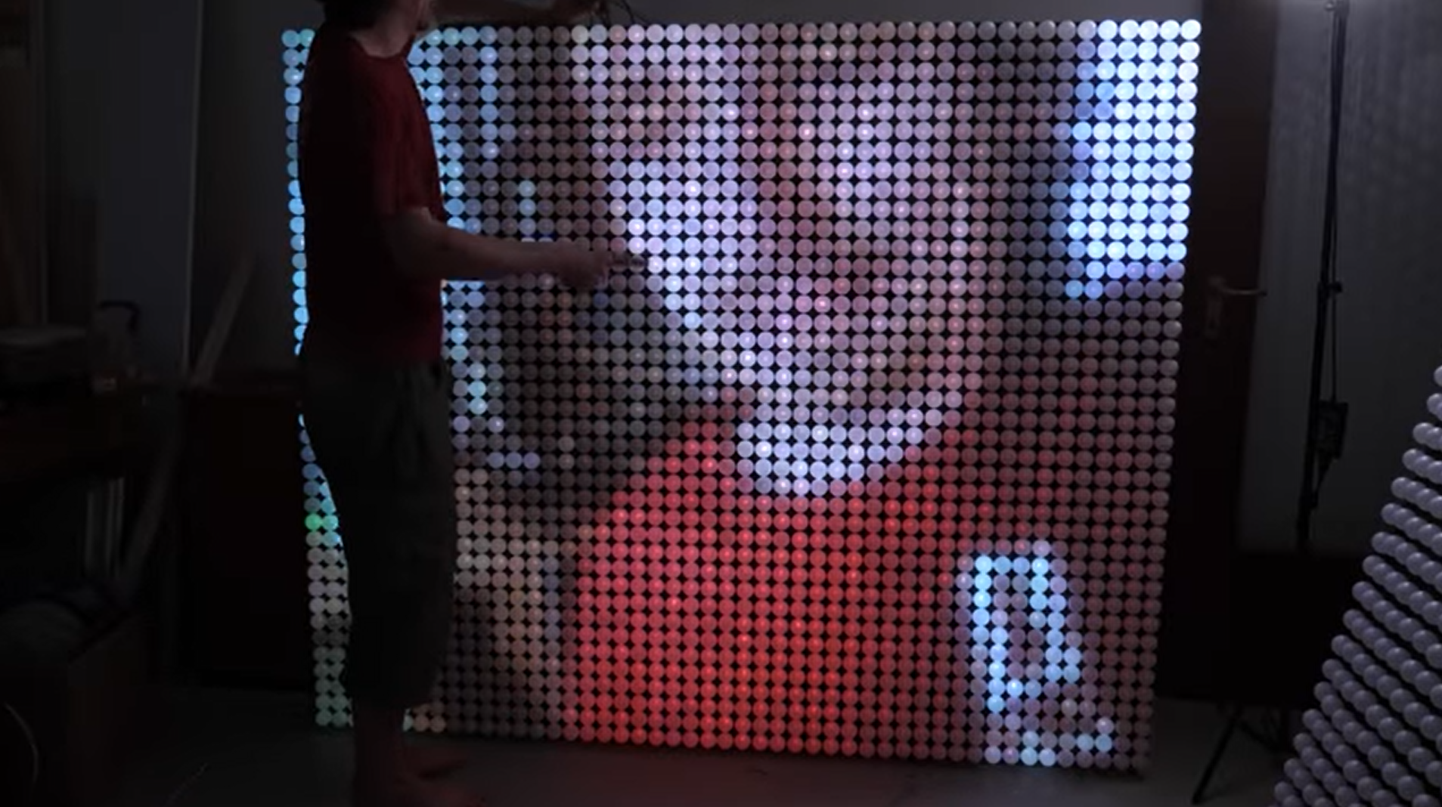
Notes:
https://youtu.be/EZEMK-C-nSo

Slide 13

Notes:
https://youtu.be/EZEMK-C-nSo

Slide 14
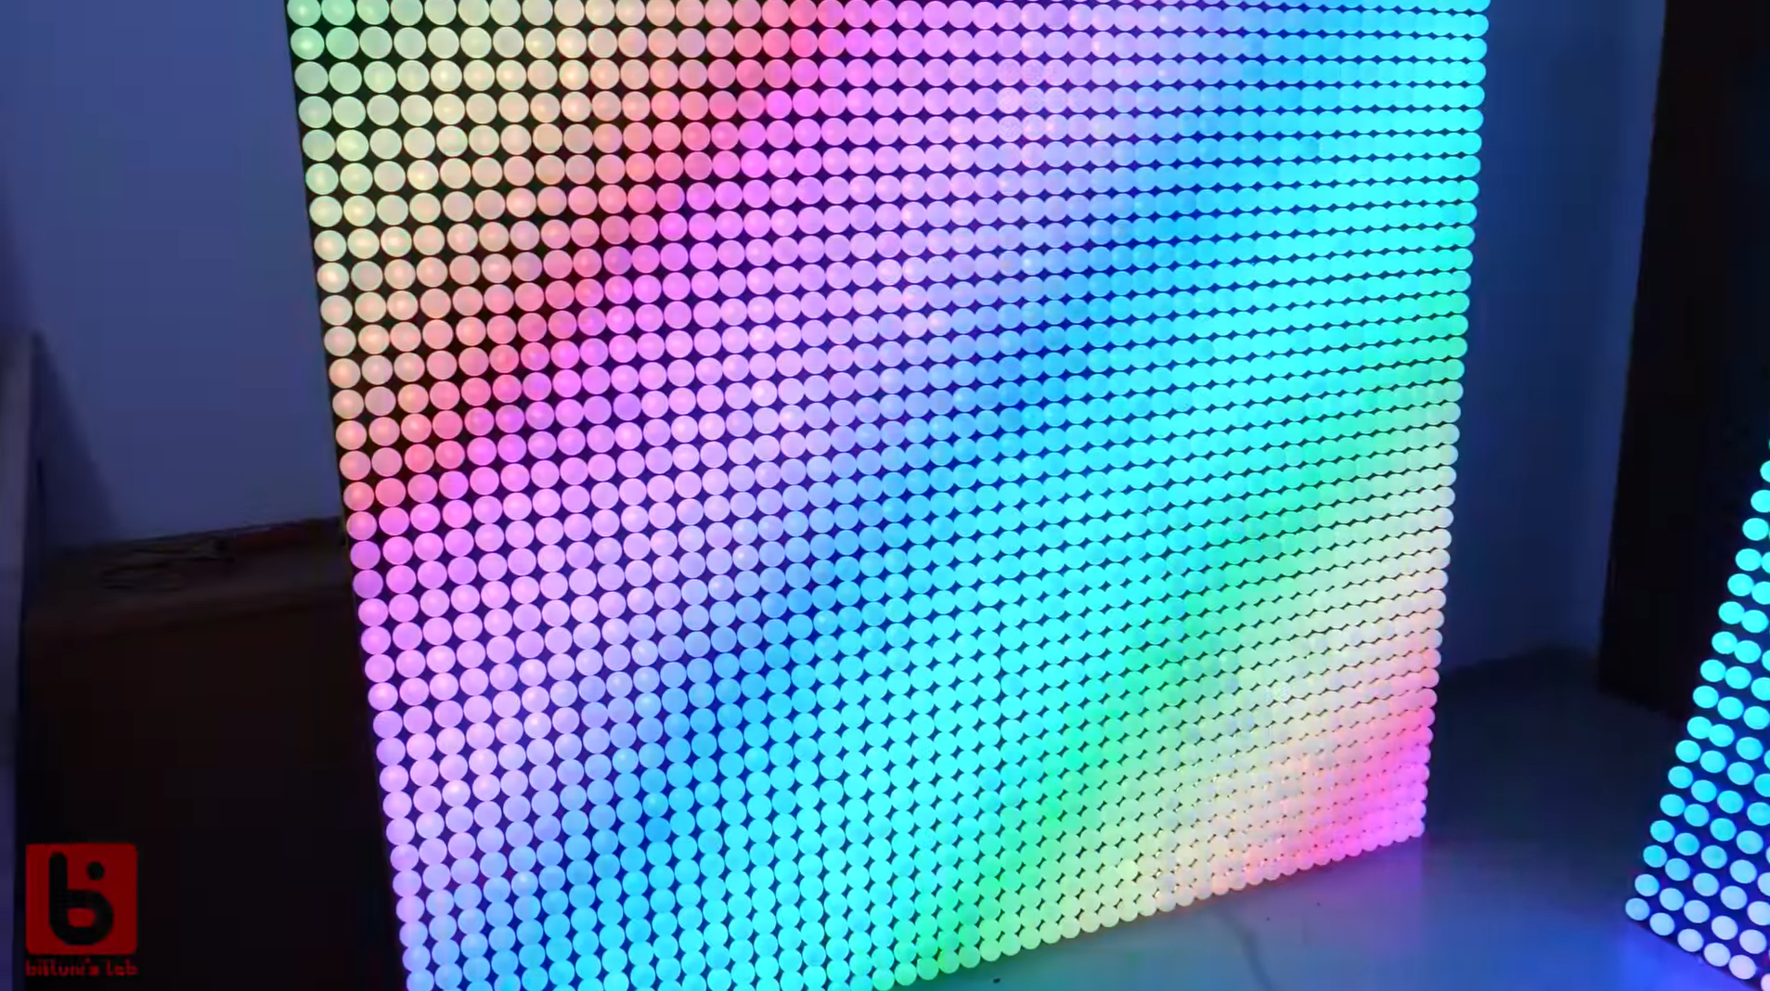
Notes:
https://youtu.be/EZEMK-C-nSo

Slide 15

Using LEDS
What is a Light-emitting diode (LED)?
LEDs emit light when certain voltage and current requirements are met.
- Cathode
+ Anode

Slide 16
Circuit Schematics: Common Electronic Symbols
+
-
Voltage source
Current source
Battery
Resistive light (lamp)
Resistor
Switch
Diode
LED
(light-emitting diode)

Slide 17
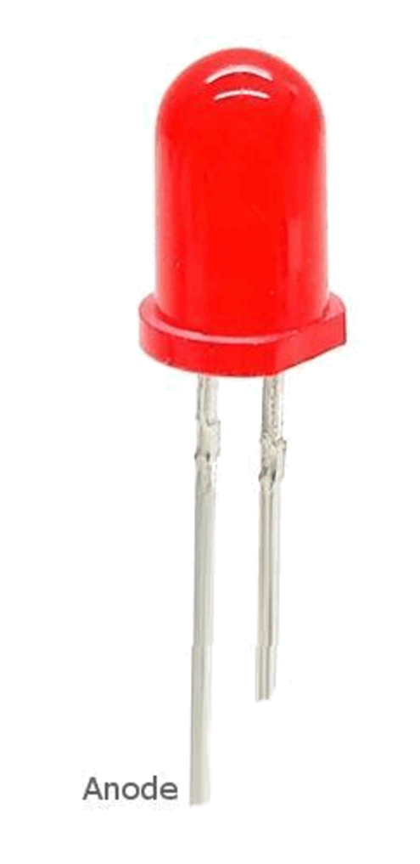
- Cathode
+ Anode

Slide 18
Casing’s flat edge is cathode
Long leg is anode
-
+
V_{F}
+
-
Anode
Cathode
I_{F}

Slide 19
I_{F}
V_{F}
+
-
Casing’s flat edge is cathode
Anode
Cathode
I_{F}
Long leg is anode
-
+
V_{F}

Slide 20
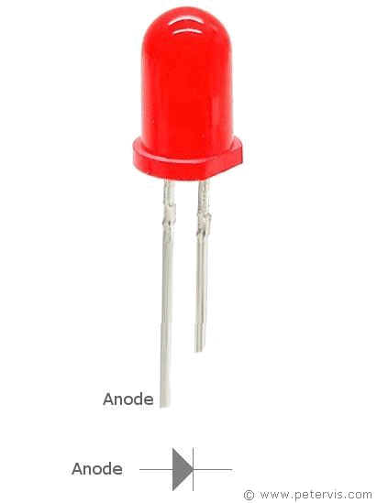
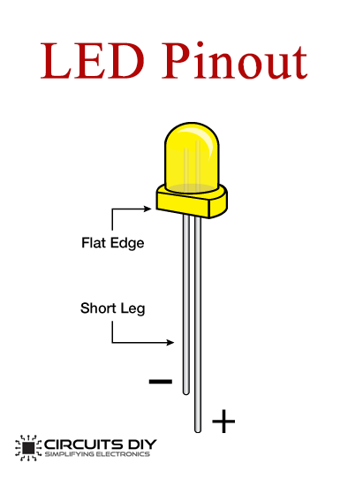
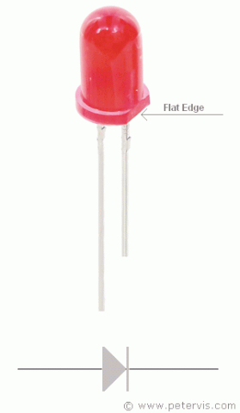

Slide 22
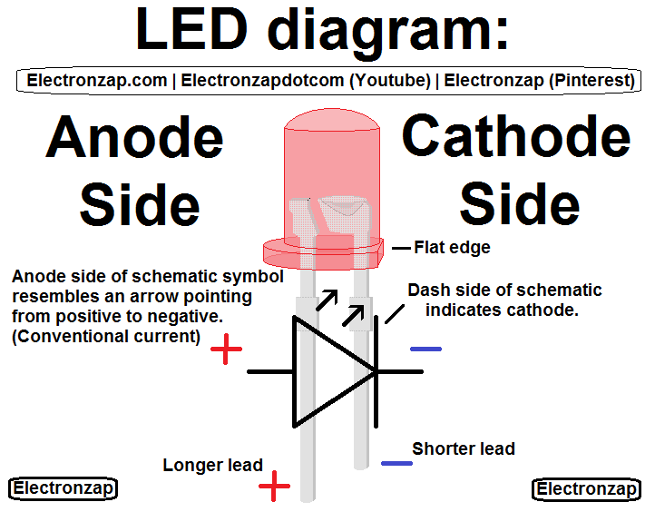

Slide 23
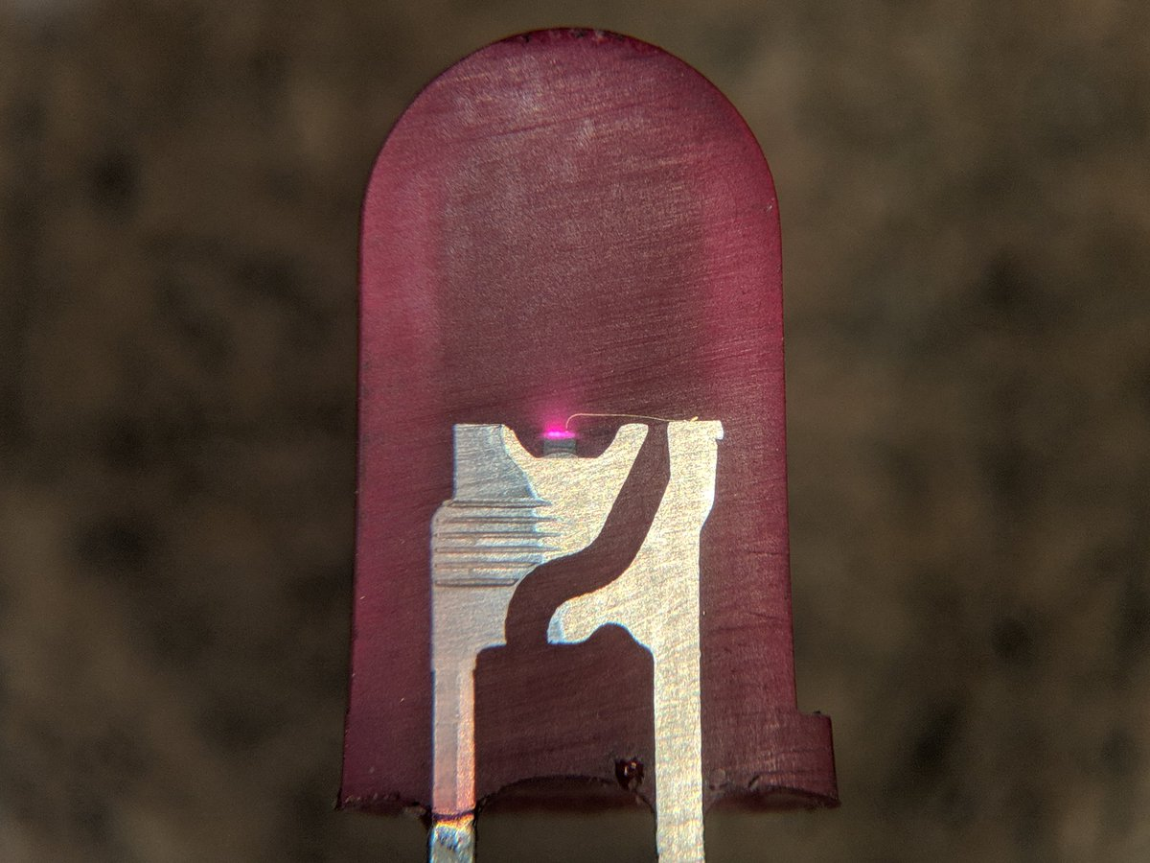
LEDS
LED Cross Section
Source: @TubeTimeUS, https://twitter.com/tubetimeus/status/1111807450141745152?s=11
Notes:
A light-emitting diode (LED) is a semiconductor light source that emits light when current flows through it. Electrons in the semiconductor recombine with electron holes, releasing energy in the form of photons. The color of the light (corresponding to the energy of the photons) is determined by the energy required for electrons to cross the band gap of the semiconductor.^{[5]} White light is obtained by using multiple semiconductors or a layer of light-emitting phosphor on the semiconductor device.^{[6]}
Appearing as practical electronic components in 1962, the earliest LEDs emitted low-intensity infrared light.^{[7]} Infrared LEDs are used in remote-control circuits, such as those used with a wide variety of consumer electronics. The first visible-light LEDs were of low intensity and limited to red. Modern LEDs are available across the visible, ultraviolet, and infrared wavelengths, with high light output.
----
https://twitter.com/tubetimeus/status/1111807450141745152?s=11

Slide 24
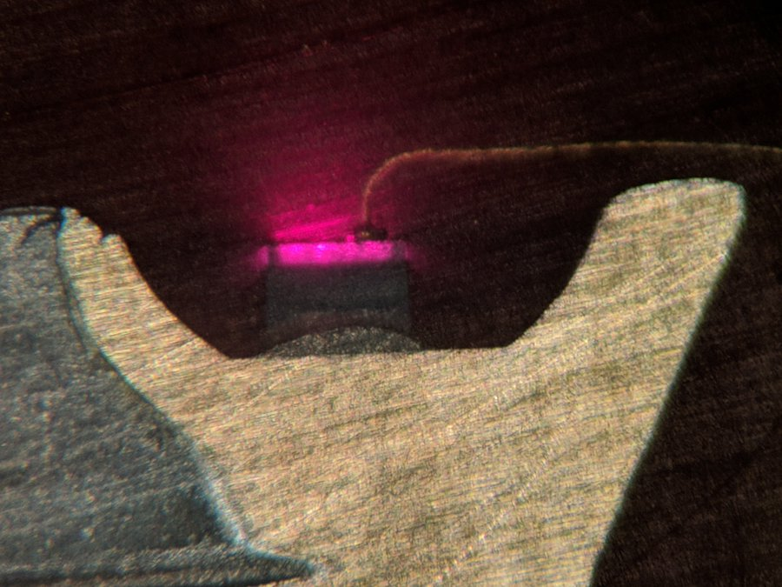
Epoxy casing
Bond wire
LED Die
Cathode
Anode
Notes:
A light-emitting diode (LED) is a semiconductor light source that emits light when current flows through it. Electrons in the semiconductor recombine with electron holes, releasing energy in the form of photons. The color of the light (corresponding to the energy of the photons) is determined by the energy required for electrons to cross the band gap of the semiconductor.^{[5]} White light is obtained by using multiple semiconductors or a layer of light-emitting phosphor on the semiconductor device.^{[6]}
Appearing as practical electronic components in 1962, the earliest LEDs emitted low-intensity infrared light.^{[7]} Infrared LEDs are used in remote-control circuits, such as those used with a wide variety of consumer electronics. The first visible-light LEDs were of low intensity and limited to red. Modern LEDs are available across the visible, ultraviolet, and infrared wavelengths, with high light output.
----
https://twitter.com/tubetimeus/status/1111807450141745152?s=11

Slide 25
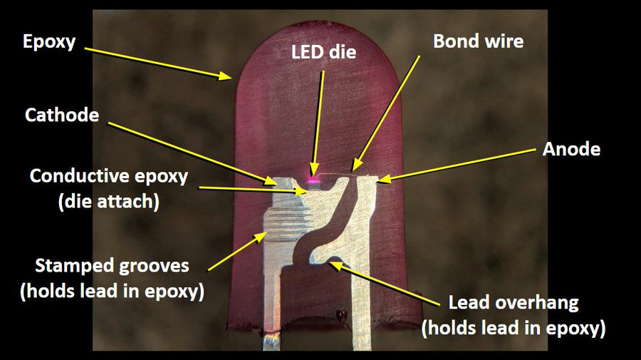
Source: @TubeTimeUS, https://twitter.com/tubetimeus/status/1111807450141745152?s=11
Notes:
https://twitter.com/tubetimeus/status/1111807450141745152?s=11
---
A light-emitting diode (LED) is a semiconductor light source that emits light when current flows through it. Electrons in the semiconductor recombine with electron holes, releasing energy in the form of photons. The color of the light (corresponding to the energy of the photons) is determined by the energy required for electrons to cross the band gap of the semiconductor.^{[5]} White light is obtained by using multiple semiconductors or a layer of light-emitting phosphor on the semiconductor device.^{[6]}
Appearing as practical electronic components in 1962, the earliest LEDs emitted low-intensity infrared light.^{[7]} Infrared LEDs are used in remote-control circuits, such as those used with a wide variety of consumer electronics. The first visible-light LEDs were of low intensity and limited to red. Modern LEDs are available across the visible, ultraviolet, and infrared wavelengths, with high light output.

Slide 26

LEDS
LED Die Close up
Source: @TubeTimeUS, https://twitter.com/tubetimeus/status/1111807450141745152?s=11
Notes:
https://twitter.com/tubetimeus/status/1111807450141745152?s=11

Slide 27
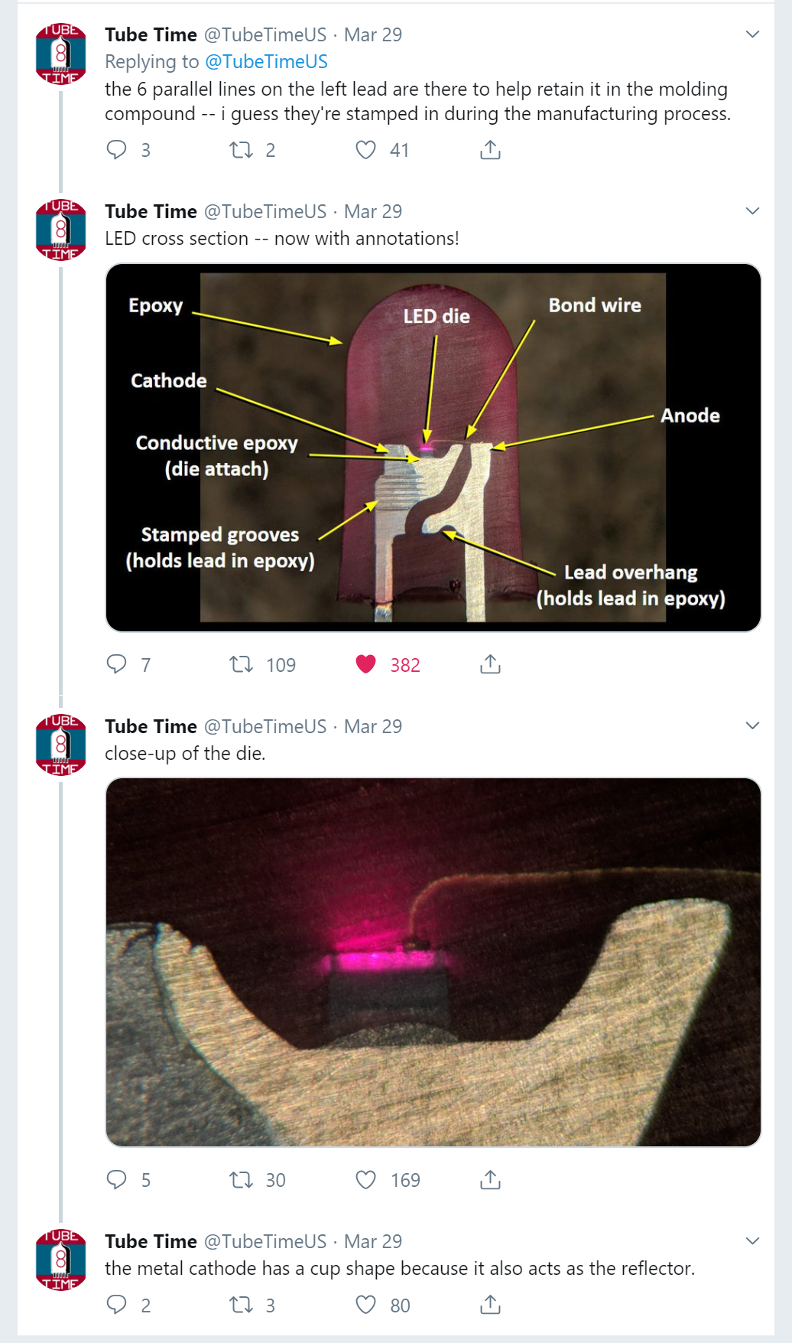
LEDS
LED Cross Section
Source: @TubeTimeUS, https://twitter.com/tubetimeus/status/1111807450141745152?s=11
Notes:
https://twitter.com/tubetimeus/status/1111807450141745152?s=11

Slide 28

Using LEDS
Light-emitting diodes (LEDS)
LEDs require current limiting resistors. Do not hook up an LED directly to a power source without a resistor or the LED could burn out.
-
+
The “long leg” indicates the anode.
Resistor
- Cathode
+ Anode
Unlike resistors, LEDs have polarity. They only allow current to flow in one direction. The long leg (the anode) must be connected towards positive supply voltage.

Slide 29
Using LEDS
Current limiting resistor can be on either side of led
The current limiting resistor can be on either side of the LED (this can be shown with Ohm’s Law, which we will soon learn about)
-
+
-
+
Resistor
Resistor

Slide 30
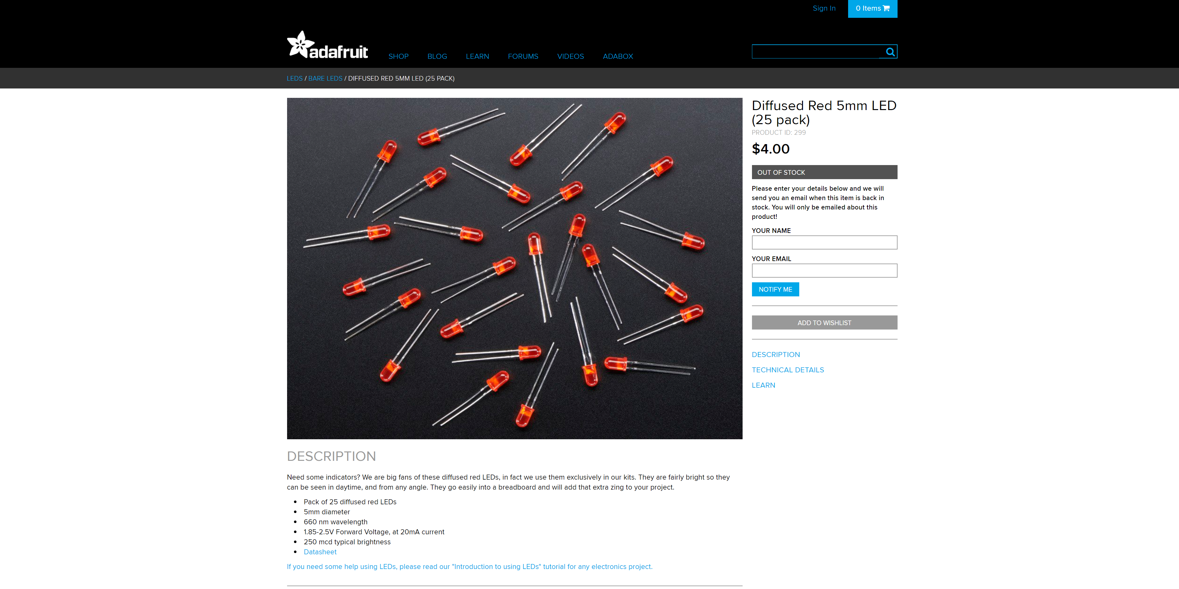
Diodes: Forward Voltage
Using LEDs
diodes: Forward voltage
A diode (including an LED) won’t allow current through unless a forward voltage condition is met. The LED’s datasheet will tell you what this is (e.g., 1.8-2.5V). Let’s use another water analogy.
TODO: Maybe have two animations—one where forward voltage condition met, other where not met.
Use basic circuit from before
Source:: http://husk.eecs.berkeley.edu/courses/cs294-84-fall14/images/a/a3/Slides-02-electronics101.pdf
Notes:
http://husk.eecs.berkeley.edu/courses/cs294-84-fall14/images/a/a3/Slides-02-electronics101.pdf

Slide 31
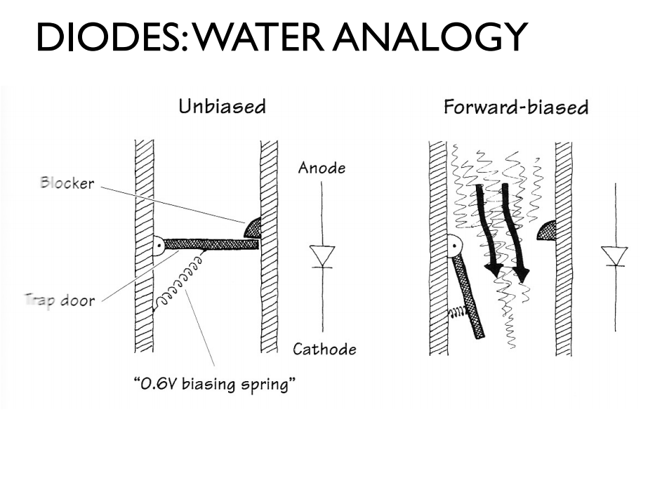
Diodes: Forward Voltage
Using LEDs
diodes: Forward voltage
A diode (including an LED) won’t allow current through unless a forward voltage condition is met. The LED datasheet will tell you what this is (e.g., 1.8-2.5V). Let’s use another water analogy.
Imagine this trap door won’t open unless a certain water pressure threshold is met (this is the forward voltage V_{f}).
Once the V_{f} threshold is met, the trap door opens and water (current) passes through.
Source:: http://husk.eecs.berkeley.edu/courses/cs294-84-fall14/images/a/a3/Slides-02-electronics101.pdf
Notes:
http://husk.eecs.berkeley.edu/courses/cs294-84-fall14/images/a/a3/Slides-02-electronics101.pdf

Slide 32
diodes: Forward voltage
Water flows only when pressure exceeds V_{f} (to open trap door)
Blocker
Trap Door
Water can never flow this direction
Imagine this trap door won’t open unless a certain water pressure threshold is met (this is the forward voltage V_{f} , which is sometimes called the “on” voltage V_{on}).
Once the V_{f} threshold is met, the trap door opens and water (current) passes through.
Source:: http://husk.eecs.berkeley.edu/courses/cs294-84-fall14/images/a/a3/Slides-02-electronics101.pdf
Notes:
http://husk.eecs.berkeley.edu/courses/cs294-84-fall14/images/a/a3/Slides-02-electronics101.pdf

Slide 33
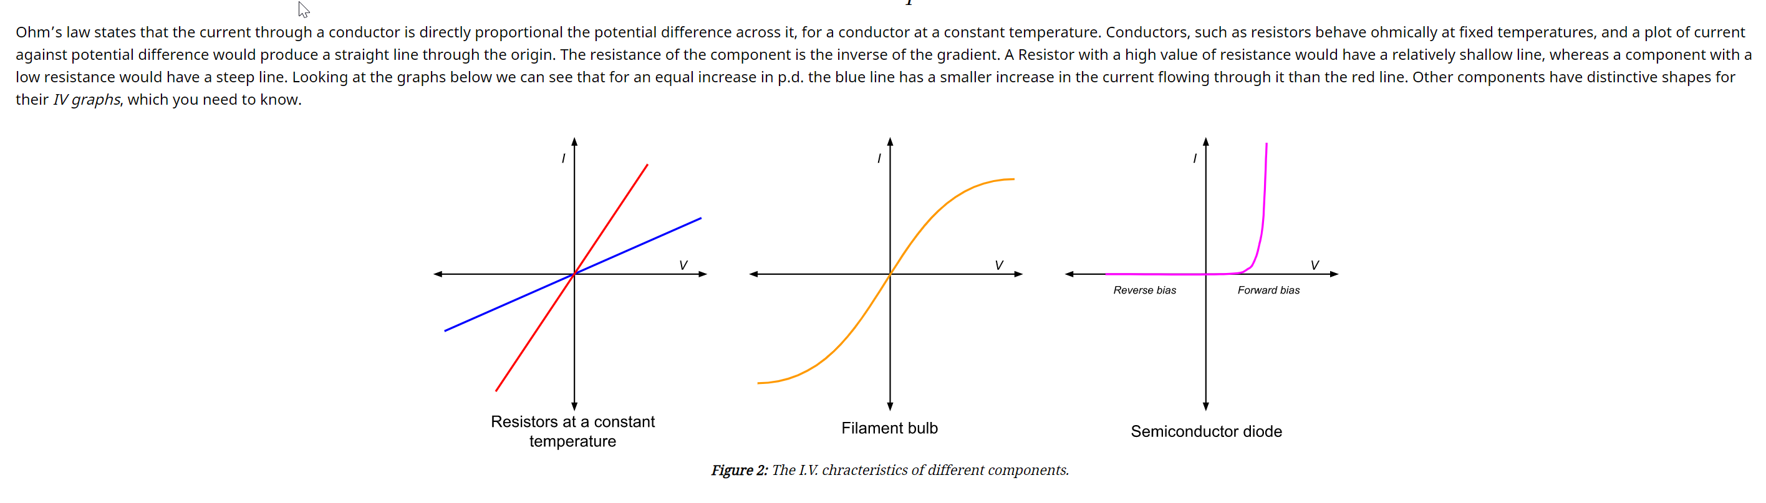
Notes:
http://www.alevelphysicsnotes.com/electricity/resistors.php

Slide 34
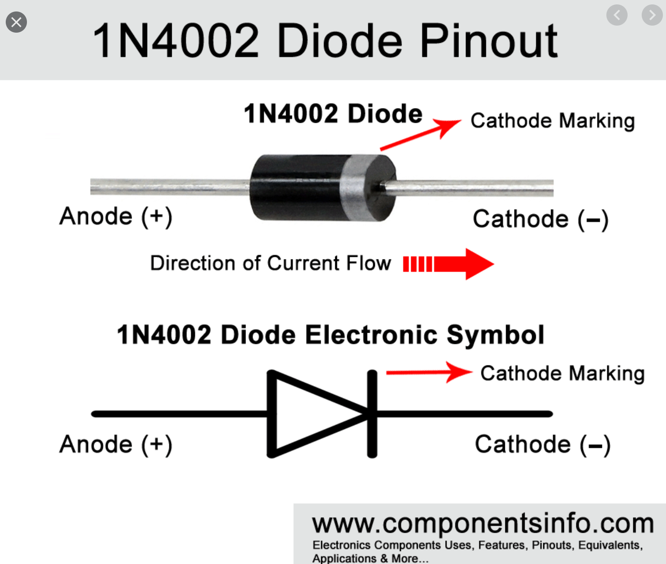
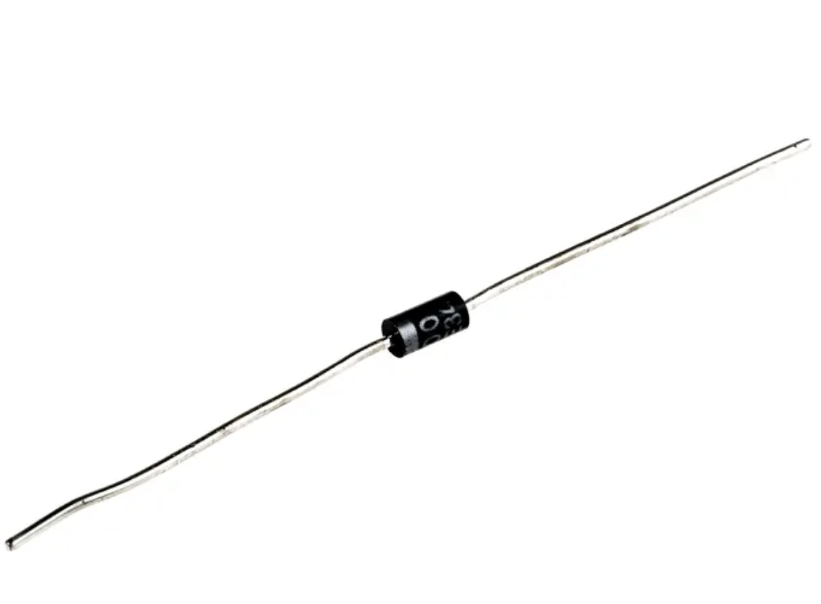
V_{D}
Cathode marking
(vertical line)
V_{D}
Cathode marking
(vertical gray line)
+
-
+
-
Anode
Cathode
Anode
Cathode
I_{D}
I_{D}

Slide 35
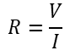
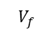
I
Resistor
I
Diode
$$R=\frac{V}{I}$$
V
$$V_{f}$$
V
Notes:
http://www.alevelphysicsnotes.com/electricity/resistors.php

Slide 36
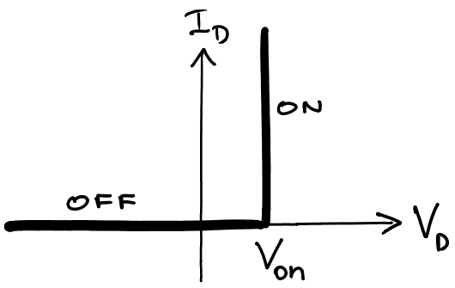
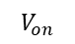
I
Diode
modeled as
$$V_{on}$$
V
Notes:
http://www.alevelphysicsnotes.com/electricity/resistors.php

Slide 37
I
Diode
modeled as
$$V_{on}$$
V
Notes:
http://www.alevelphysicsnotes.com/electricity/resistors.php

Slide 38
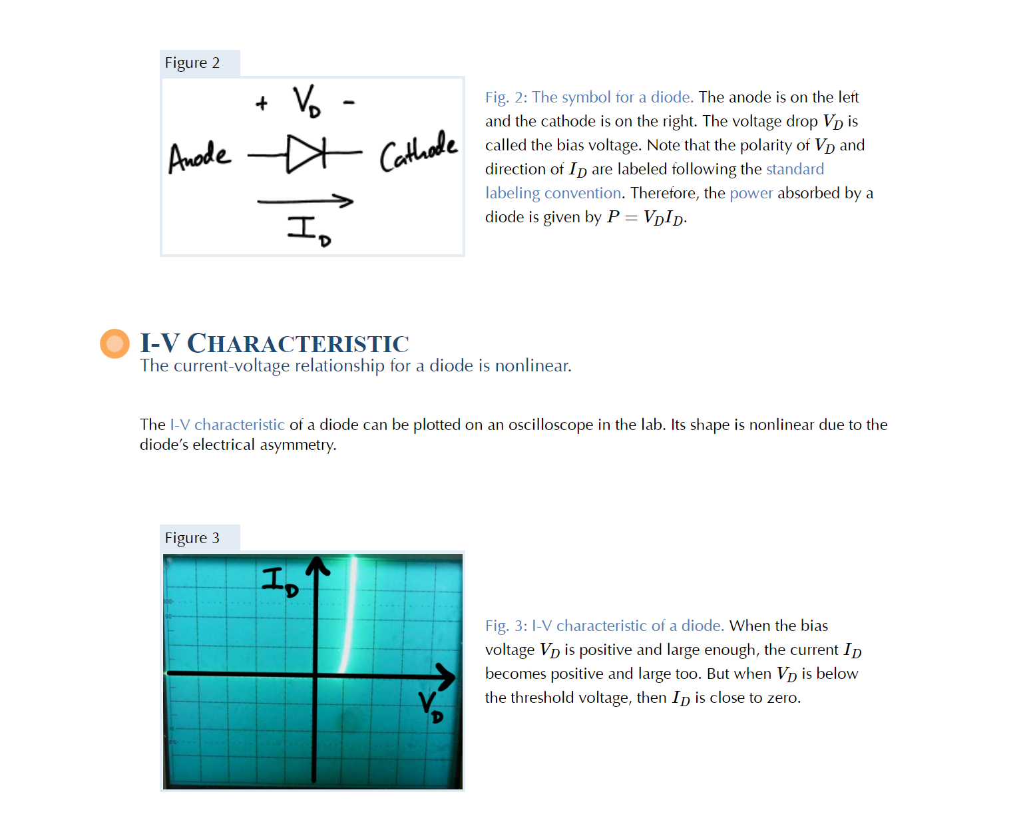

Slide 39
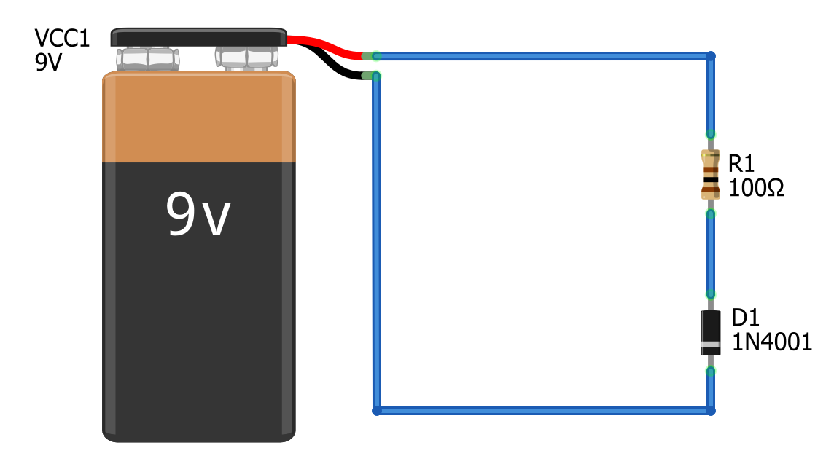
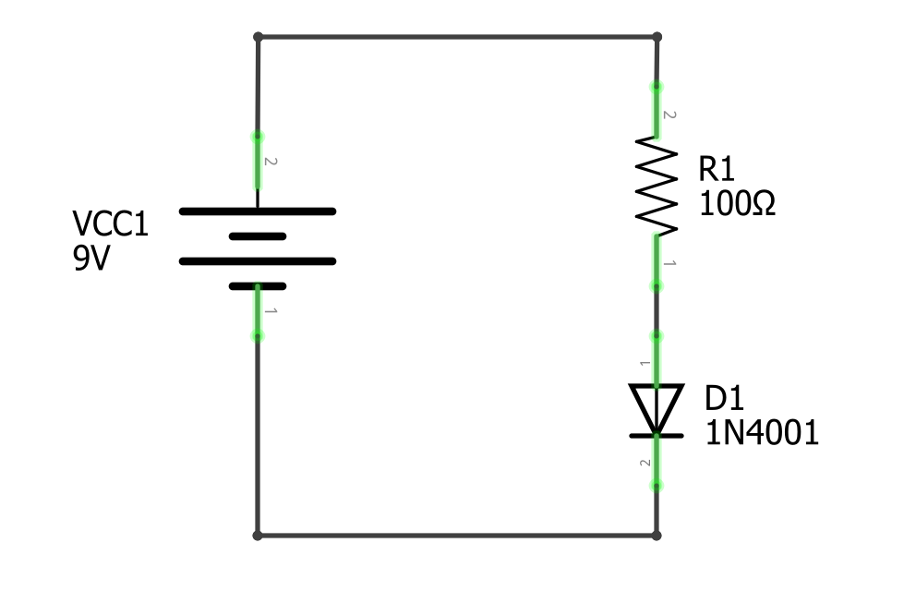
I = ?

Slide 40
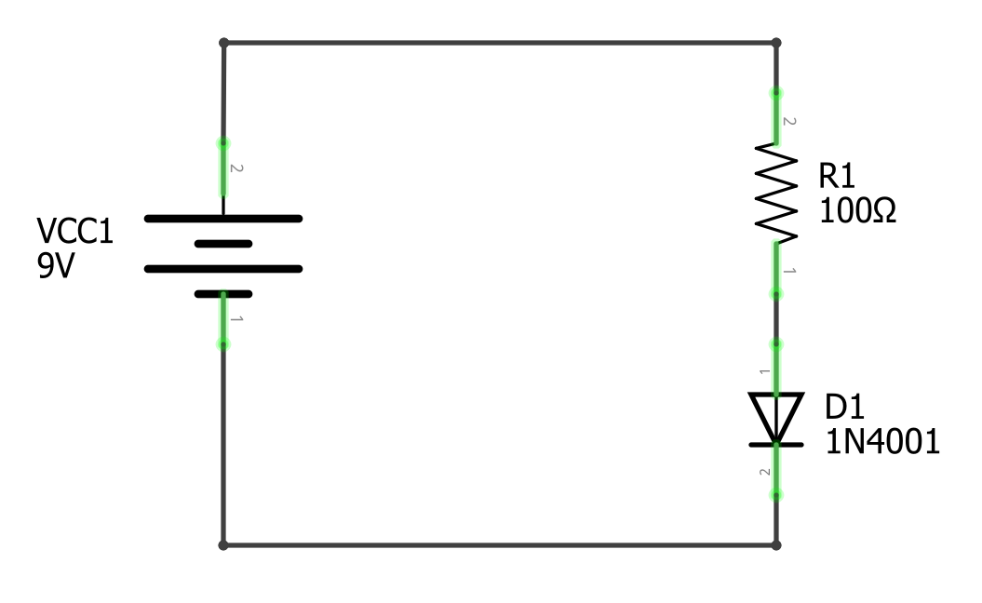
Circuit Schematics: Common Electronic Symbols
V_{A} = 9V
+
+
How much current I is flowing through this circuit.
V_{R}
How much current I is flowing through this circuit.
-
V_{S}
V_{B}
+
V_{D}
-
V_{C} = 0V
-

Slide 41
Solve for Current I in resistor-diode circuit
How much current I is flowing through this circuit.
How much current I is flowing through this circuit.

Slide 42
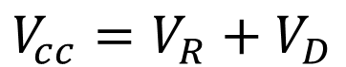
Step 1: identify nodes and voltage drops
Node A
Node A
+
+
+
+
V_{R}
V_{R}
Node B
V_{cc}
Node B
-
V_{cc}
-
+
+
V_{D}
V_{D}
-
-
-
-
Node C
Node C
From Kirchhoff’s Voltage Law we know that the sum of all voltages in a closed loop in a circuit equals zero:
$$V_{cc}=V_{R}+V_{D}$$

Slide 43
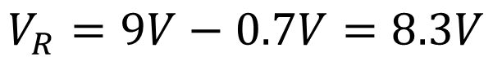
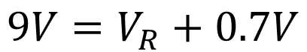
Step 2: solve for V_{R}
Node A
Node A
+
+
+
+
V_{R}
V_{R}
Node B
V_{cc}
Node B
-
V_{cc}
-
+
+
V_{D}
V_{D}
-
-
-
-
Node C
Node C
From Kirchhoff’s Voltage Law we know that the sum of all voltages in a closed loop in a circuit equals zero. Thus, V_{cc} must equal the sum of voltage drops over V_{R} + V_{D.}
$$V_{cc}=V_{R}+V_{D}$$
$$9V=V_{R}+0.7V$$
$$V_{R}=9V−0.7V=8.3V$$

Slide 44
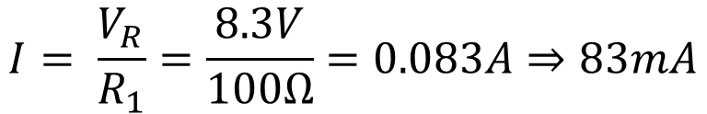
Step 3: solve for current I
+
+
+
+
V_{R} = 8.3V
How much current I is flowing through this circuit.
V_{R} = 8.3V
How much current I is flowing through this circuit.
-
V_{CC} = 9V
-
V_{CC} = 9V
+
+
V_{D} = 0.7V
V_{D} = 0.7V
-
-
-
-
Once V_{D} = V_{f}, we can treat the diode as a simple wire, contributing almost no resistance. Thus, the current through our circuit is simply a function of R₁.
$$I= \frac{V_{R}}{R_{1}}=\frac{8.3V}{100Ω}=0.083A⇒83mA$$

Slide 45

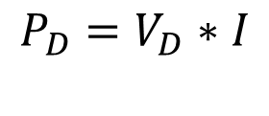


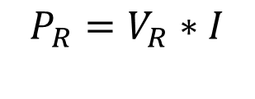

Step 4: solve for power absorption at resistor and diode
+
+
+
+
V_{R} = 8.3V
V_{R} = 8.3V
I = 83mA
-
V_{CC} = 9V
I = 83mA
-
V_{CC} = 9V
+
+
V_{D} = 0.7V
V_{D} = 0.7V
-
-
-
-
Power dissipated at resistor R₁
Power dissipated at diode D₁
$$P_{R}=V_{R}∗I$$
$$P_{D}=V_{D}∗I$$
$$P_{R}=8.3V ∗0.083A$$
$$P_{R}=0.7V ∗0.083A$$
$$P_{R}=0.69W$$
$$P_{R}=0.058W$$

Slide 46

Circuit Schematics: Common Electronic Symbols
Node A
+
+
V_{R}
How much current I is flowing through this circuit.
Node B
V_{S}
-
+
V_{D}
-
-
Node C
$$V_{S}={}_{}πr^{2}+{}_{}$$

Slide 47
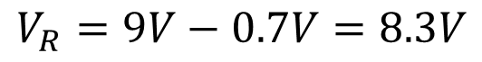
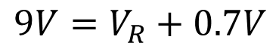
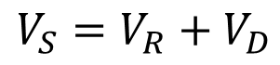
Circuit Schematics: Common Electronic Symbols
Node A
+
+
V_{R}
How much current I is flowing through this circuit.
Node B
V_{S}
-
+
V_{D}
-
-
Node C
$$V_{S}=V_{R}+V_{D}$$
$$9V=V_{R}+0.7V$$
$$V_{R}=9V−0.7V=8.3V$$

Slide 48
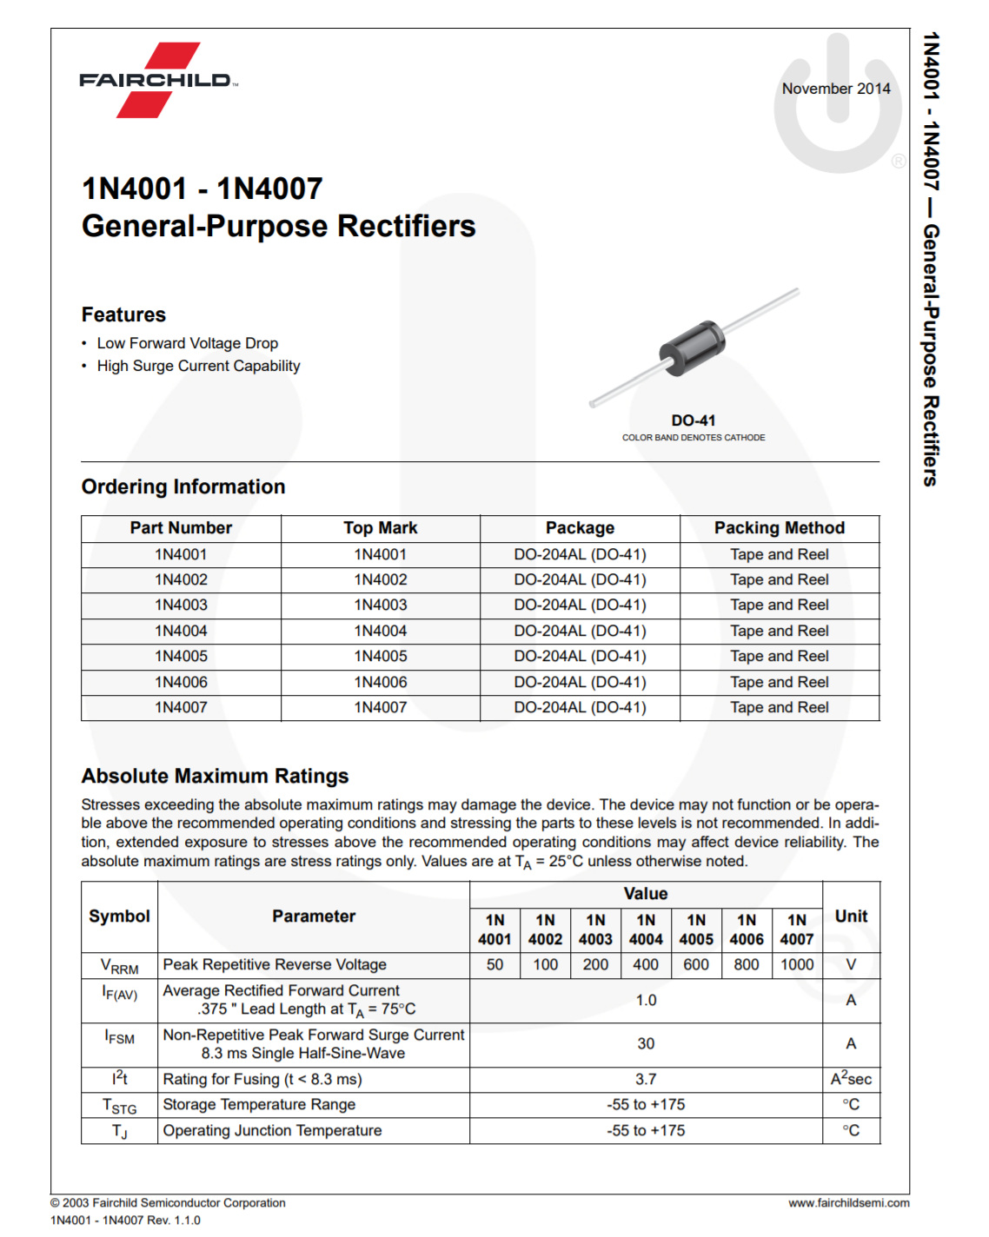

Slide 49
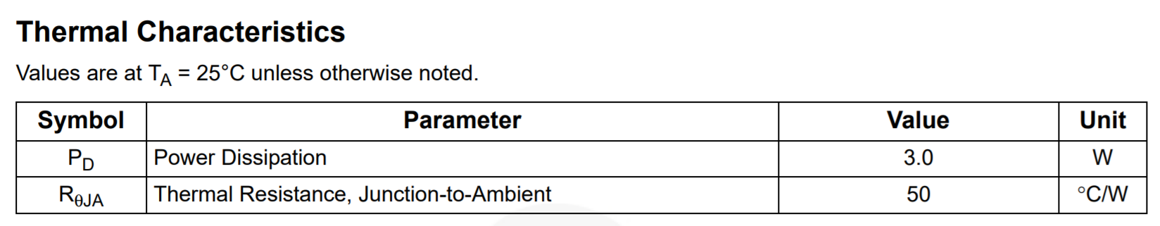
Notes:
https://www.mouser.com/datasheet/2/149/1N4001-81693.pdf

Slide 50
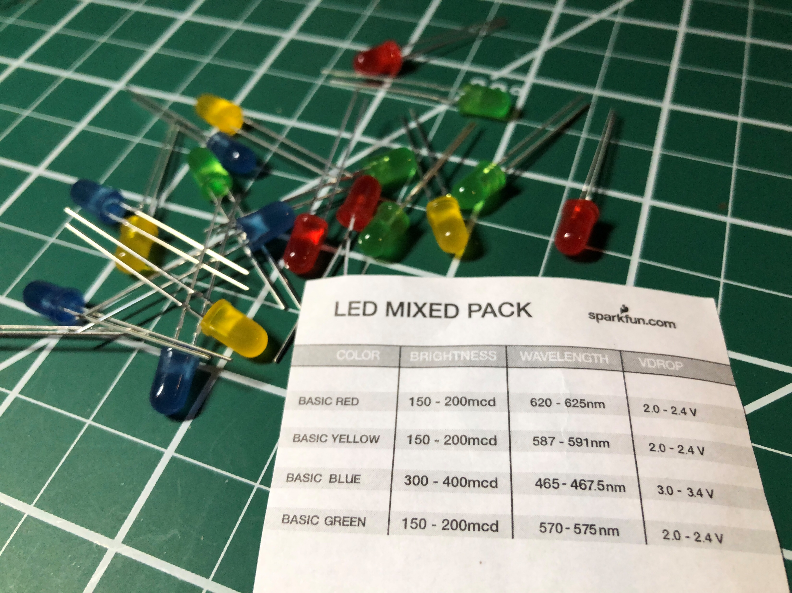

Slide 51
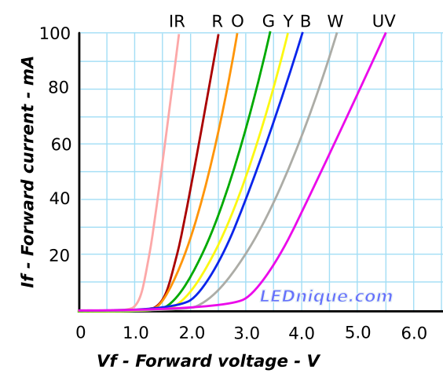


Slide 53
2V 40mA
2V 12mA
2V 3mA

Slide 54
2V 40mA
2V 12mA
2V 3mA

Slide 55
2V
40mA
12mA
3mA

Slide 57
Notes:
Experiment 1: step by 0.1V increments

Slide 58
Notes:
Experiment 2: up by 0.01V

Slide 59






Notes:
Experiment 2: up by 0.01V

Slide 60





Slide 62

Leds have different forward voltages
Using LEDs
Figures from: https://electronics.stackexchange.com/a/396350
Notes:
LEDs have different forward voltages with infrared and red LEDs have the lowest and blue, white, and ultra-violet having the highest
For example, at 1.5V, a red LED will pass ~20MA of current while a yellow LED would still be off
At 2.5V, a red LED passes ~45mA and a yellow LED 25mA

Slide 63


Solve for Current-limiting resistor R1 value
R1=??
R1=??

Slide 64
Step 1: Identify our knowns and nodes
Node A
Node A
+
+
+
+
V_{R} = ??
R1=??
V_{R} = ??
R1=??
Node B
-
V_{CC} = 9V
Node B
-
V_{CC} = 9V
+
+
V_{D} = 2V
V_{D} = 2V
-
-
-
-
Node C
Node C

Slide 65



Step 2: solve for V_{R}
Node A
Node A
+
+
+
+
V_{R} = 7V
R1=??
V_{R} = 7V
R1=??
Node B
-
V_{CC} = 9V
Node B
-
V_{CC} = 9V
+
+
V_{D} = 2V
V_{D} = 2V
-
-
-
-
Node C
Node C
From Kirchhoff’s Voltage Law we know that the sum of all voltages in a closed loop in a circuit equals zero:
$$V_{cc}=V_{R}+V_{D}$$
$$V_{R}=V_{CC}−V_{D}$$
$$V_{R}=9V −2V=7V$$

Slide 66

Step 3: consult data sheet for I_{F} at V_{f} =2V
+
+
+
+
V_{R} = 7V
R1=??
V_{R} = 7V
I = 20mA
R1=??
I = 20mA
-
V_{CC} = 9V
-
V_{CC} = 9V
+
+
V_{D} = 2V
V_{D} = 2V
-
-
-
-

Slide 67

Step 4: solve for R1
+
+
+
+
V_{R} = 7V
R1=
350Ω
V_{R} = 7V
I = 20mA
R1= 350Ω
I = 20mA
-
V_{CC} = 9V
-
V_{CC} = 9V
+
+
V_{D} = 2V
V_{D} = 2V
-
-
-
-
We can solve for the resistance of R1 using Ohm’s Law now that we know the current I and voltage V_{R}
$$R1=\frac{V_{R}}{I}=\frac{7V}{0.02A}=350 Ω$$

Slide 68






What resistor to use? 330Ω or 470Ω?
+
+
+
+
R1=
330Ω
V_{R} = 7V
R1=
330Ω
V_{R} = 7V
I = 21.2 mA
-
I = 14.9 mA
-
V_{CC} = 9V
V_{CC} = 9V
+
+
V_{D} = 2V
V_{D} = 2V
-
-
-
-
$$I=\frac{V_{R}}{R}=\frac{7V}{330Ω}=21.2mA$$
$$I=\frac{V_{R}}{R}=\frac{7V}{470Ω}=14.9mA$$
$$P_{R}=0.0212A∗7V=0.15 W$$
$$P_{R}=0.0149A∗7V=0.10 W$$
$$P_{D}=0.0212A∗2V=0.04 W$$
$$P_{D}=0.0149A∗2V=0.03 W$$

Slide 69



Use resistor equivalence rules to get to 350Ω
$$R_{Total}=R_{1}+R_{2}+R_{3}=350Ω$$

Slide 70


Predicted vs. measured: 330Ω, 350Ω, and 470Ω
+
+
+
+
R1=
330Ω
V_{R} = 7V
R1=
330Ω
V_{R} = 7V
I = 21.2 mA
-
I = 14.9 mA
-
V_{CC} = 9V
V_{CC} = 9V
+
+
V_{D} = 2V
V_{D} = 2V
-
-
-
-
$$I=\frac{V_{R}}{R}=\frac{7V}{330Ω}=21.2mA$$
$$I=\frac{V_{R}}{R}=\frac{7V}{470Ω}=14.9mA$$
$$P_{R}=0.0212A∗7V=0.15 W$$
$$P_{R}=0.0149A∗7V=0.10 W$$
$$P_{D}=0.0212A∗2V=0.04 W$$
$$P_{D}=0.0212A∗2V=0.04 W$$

Slide 71






Predicted vs. measured: 330Ω, 350Ω, and 470Ω
R1=
330Ω
R1=
470Ω
Prediction:
$$I=\frac{{V_{cc}−V}_{R}}{R}=\frac{9.13 −2V}{332Ω}=21.5mA$$
$$I=\frac{{V_{cc}−V}_{R}}{R}=\frac{9.17 −2V}{352Ω}=20.3mA$$
$$I=\frac{{V_{cc}−V}_{R}}{R}=\frac{9.21 −2V}{472.5Ω}=15.3mA$$
Measured:

Slide 72
Step 1: Identify your knowns
+
+
+
+
R1=??
V_{R} = 7V
R1=??
V_{R} = 7V
I = 20mA
I = 20mA
-
-
V_{CC} = 9V
V_{CC} = 9V
+
+
V_{D} = 2V
V_{D} = 2V
-
-
-
-
+
+
V_{R} = 8.3V
-
V_{CC} = 9V
+
V_{D} = 0.7V
-
-

Slide 73
+
+
+
+
R1= 350Ω
V_{R} = 7V
R1= 350Ω
V_{R} = 7V
I = 20mA
I = 20mA
-
-
V_{CC} = 9V
V_{CC} = 9V
+
+
V_{D} = 2V
V_{D} = 2V
-
-
-
-
+
+
V_{R} = 8.3V
-
V_{CC} = 9V
+
V_{D} = 0.7V
-
-

Slide 75

Wiring multiple LEDs: Don’t do this
Using LEDs
One resistor
Circuit branches: current splits between each branch…
Source:: http://lednique.com/parallel-leds/
Notes:
Imagine a 2V drop across each LED… then the expected current through each is
~ 12mA for green, which is fine
~ 27mA for orange, which is quite bright (and probably close to max rating for LED)
~ But the red LED, which has the lowest Vf, will pass about 44mA, which is well above its max rating (usually at 30mA)

Slide 76
Wiring multiple LEDs: Don’t do this
Using LEDs
Why?
Because of the different operating characteristics of the LEDs. The red LED has the lowest forward voltage and will receive a disproportionate amount of current.
One resistor
Circuit branches: current splits between each branch…
Source:: http://lednique.com/parallel-leds/
Notes:
Imagine a 2V drop across each LED… then the expected current through each is
~ 12mA for green, which is fine
~ 27mA for orange, which is quite bright (and probably close to max rating for LED)
~ But the red LED, which has the lowest Vf, will pass about 44mA, which is well above its max rating (usually at 30mA)

Slide 77

Wiring multiple LEDs: Don’t do this
Using LEDs
One resistor
Circuit branches: current splits between each branch…
Source:: http://lednique.com/parallel-leds/
Notes:
Imagine a 2V drop across each LED… then the expected current through each is
~ 12mA for green, which is fine
~ 27mA for orange, which is quite bright (and probably close to max rating for LED)
~ But the red LED, which has the lowest Vf, will pass about 44mA, which is well above its max rating (usually at 30mA)

Slide 78

What if the LEDS are the same color?
Using LEDs
R
R
R
Source:: http://lednique.com/parallel-leds/
Notes:
Even if all the LEDs are the same colour we can expect some variation in forward current from LED to LED. The variation might be reduced by using LEDs from the same production lot but even the manufacturers don’t rely on this and use “binning” to grade LEDs into matched lots for sensitive applications.
http://lednique.com/parallel-leds/

Slide 79

What if they’re the same color?
Using LEDs
R
R
R
Source:: http://lednique.com/parallel-leds/
Notes:
Even if all the LEDs are the same colour we can expect some variation in forward current from LED to LED. The variation might be reduced by using LEDs from the same production lot but even the manufacturers don’t rely on this and use “binning” to grade LEDs into matched lots for sensitive applications.
http://lednique.com/parallel-leds/

Slide 80

So, How to wire multiple LEDs?
Using LEDS
Source:: http://lednique.com/parallel-leds/

Slide 81
How to wire multiple LEDs
Using LEDS
This circuit is the ideal but is generally not going to work for us if we use the Arduino’s built-in power supply (which is either 5V or 3.3V)
Why? Because there’s not sufficient supply voltage to meet the Vf requirements of each LED.
Source:: http://lednique.com/parallel-leds/

Slide 82
How to wire multiple LEDs
Using LEDS
Source:: http://lednique.com/parallel-leds/

